Slide 1

Predictive Analytics for Bank Term Deposit Subscriptions
By
Mina Botros

Slide 2
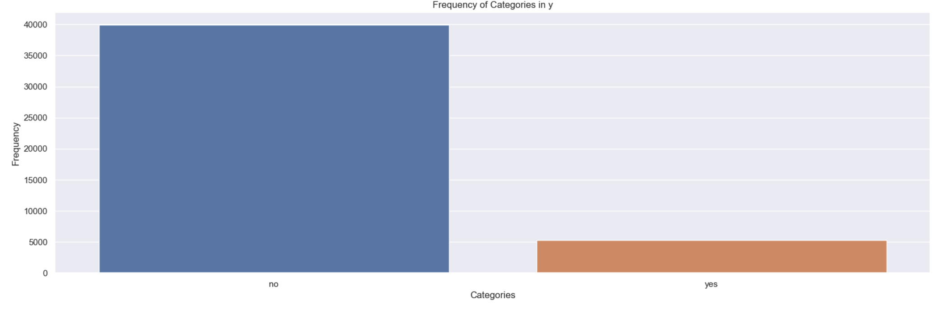
Problem Statement To predict whether an individual will subscribe to a term deposit based on
demographic information (age, job, marital status, education),
financial status (default status, balance, housing loan, personal loan),
contact history (contact duration, campaign contacts, days since previous contact, previous contacts)
Data source
https://archive.ics.uci.edu/dataset/222/bank+marketing

Slide 3

project steps
Hypothesis Generation
EDA & Data Cleaning/Polishing
Preprocessing & Feature Engineering
Training & Evaluating ML model
Findings & Conclusion
Build flask frame

Slide 4
First: Possible hypotheses
Age
Job
Marital
Education
Default
Balance
Housing
Loan
Contact
Day
Month
Duration
Campaign
Pdays
Poutcome

Slide 5
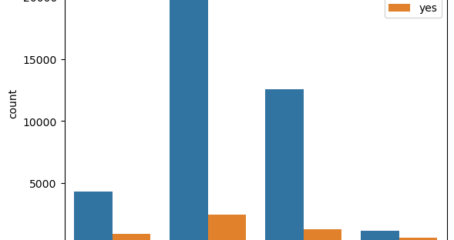
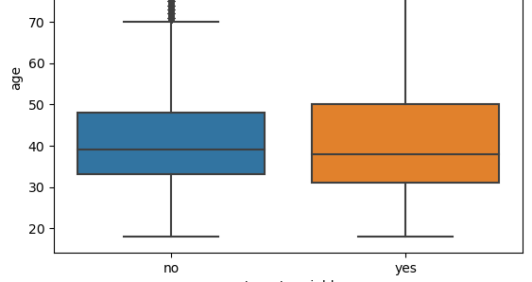
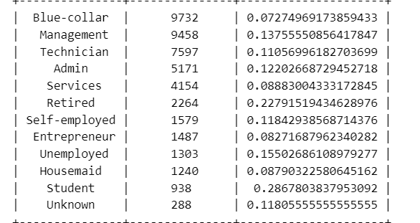
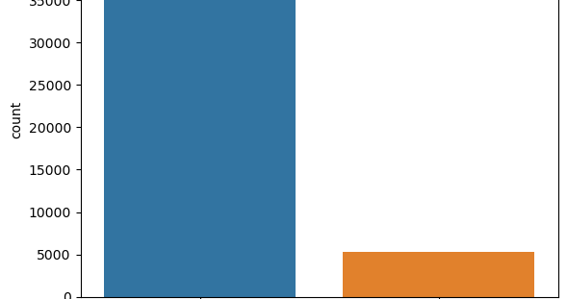
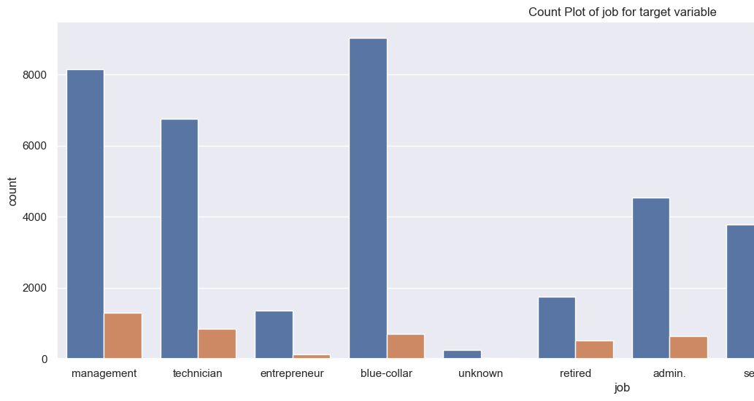
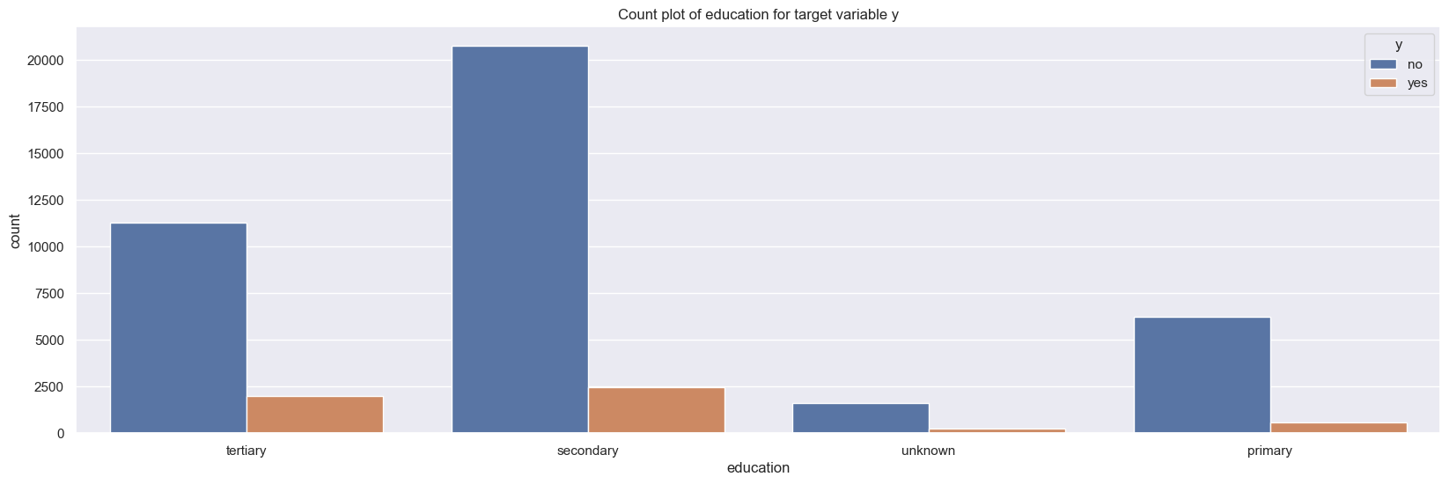
Second: EDA & Data Cleaning/Polishing

Slide 6
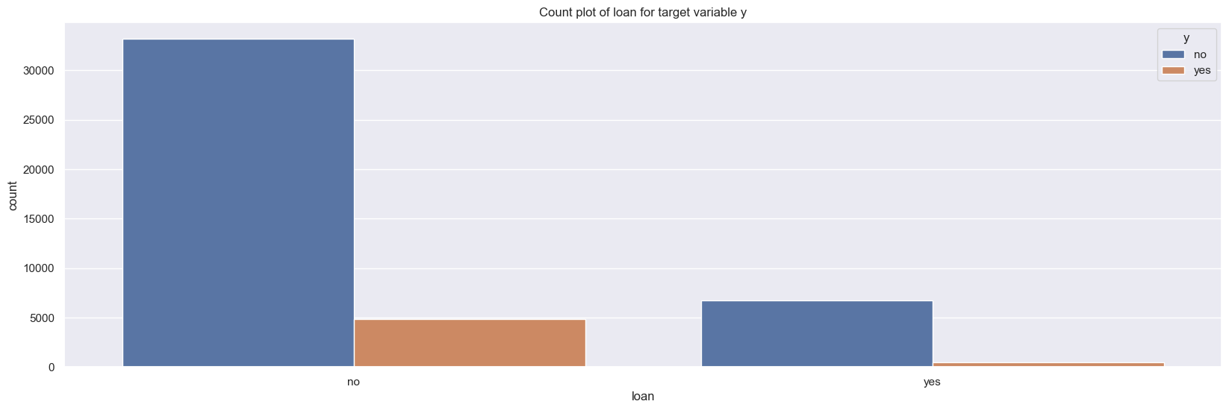
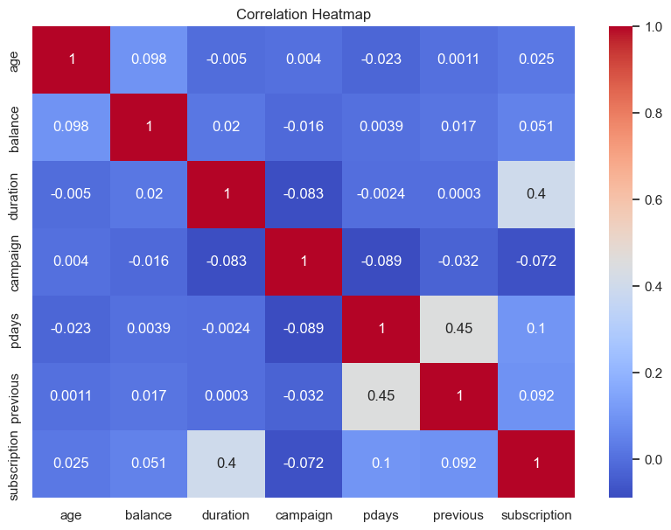
EDA & Data Cleaning/Polishing

Slide 7
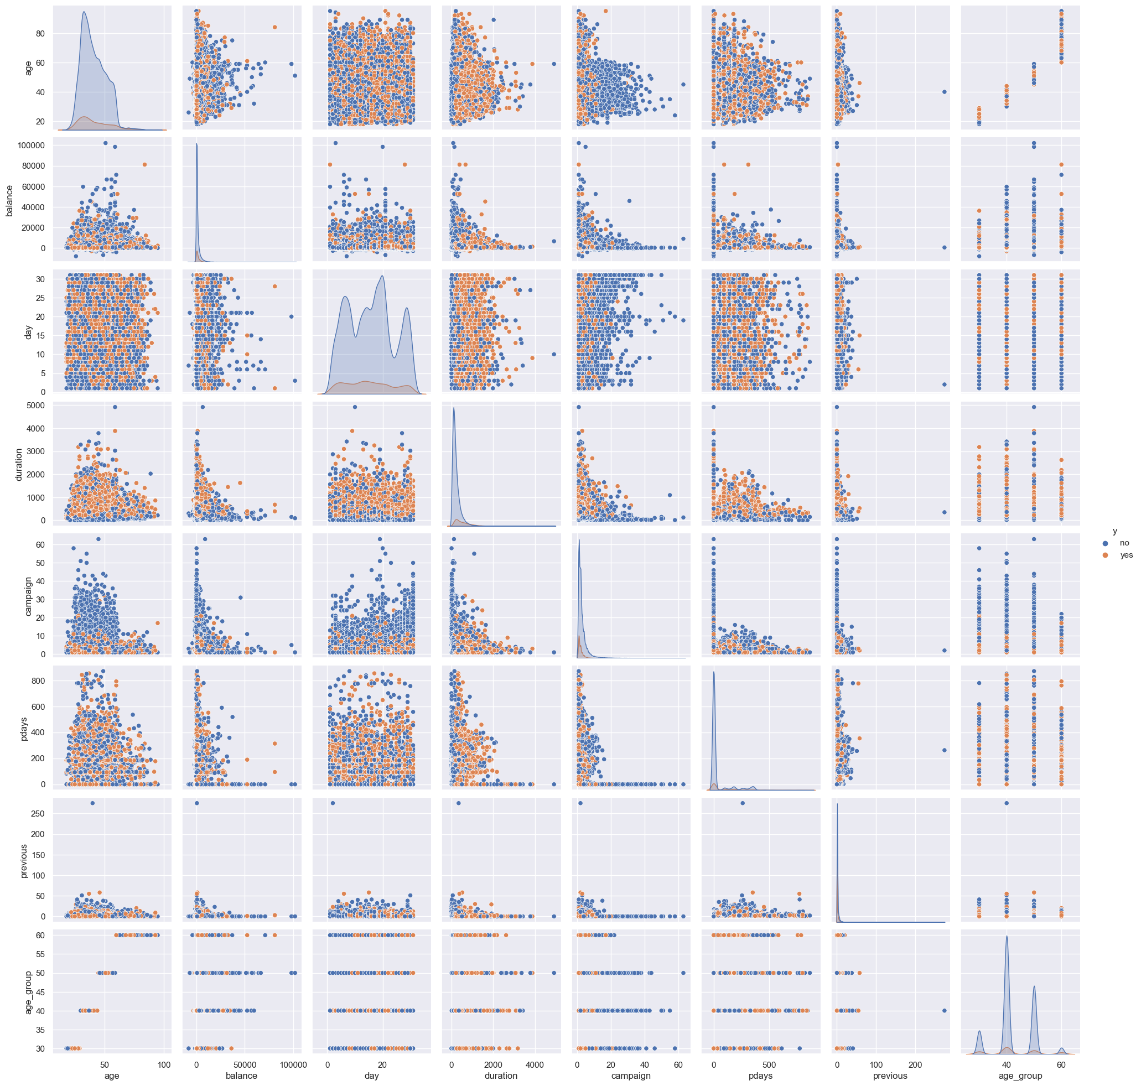
EDA & Data Cleaning/Polishing

Slide 8
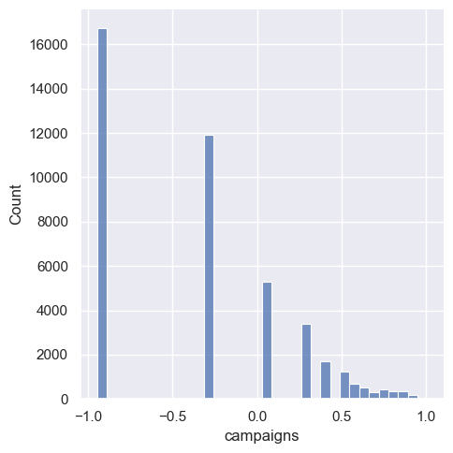
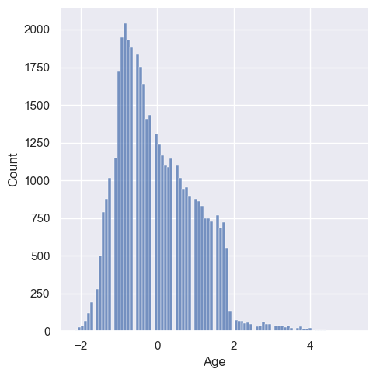
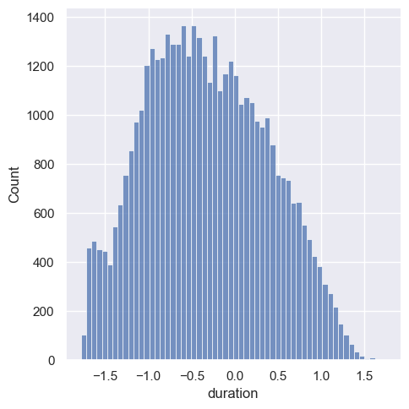
Third: Preprocessing & Feature Engineering
Scaling numerical features:
Normalizing distribution in columns with skewed distribution

Slide 9
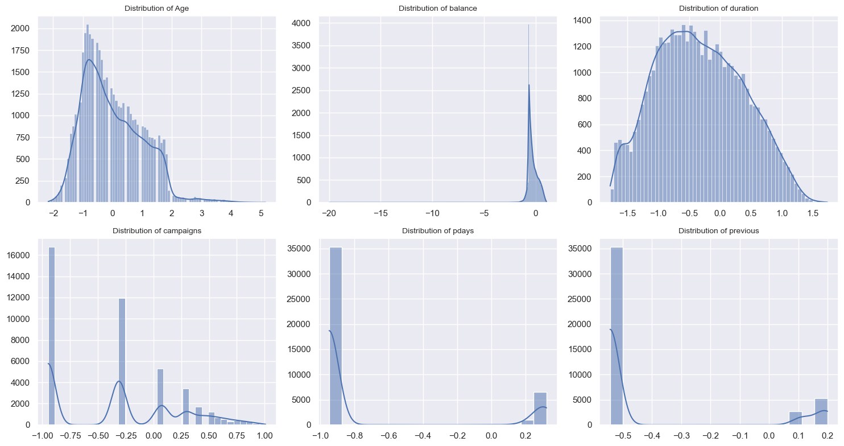
Preprocessing & Feature Engineering

Slide 10
Fourth: Training & Evaluating ML model
Logistic Regression
Support Vector Machine (SVM)
Decision Tree
K-Nearest Neighbors
Naive Bayes
Random Forest

Slide 11
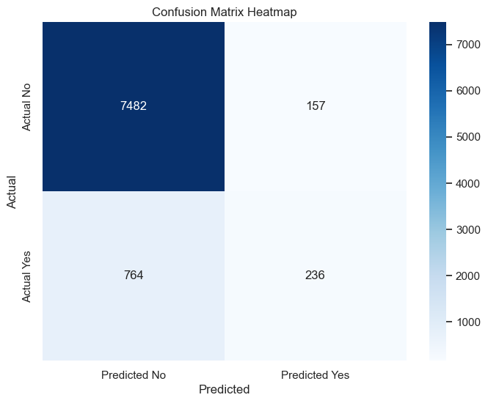
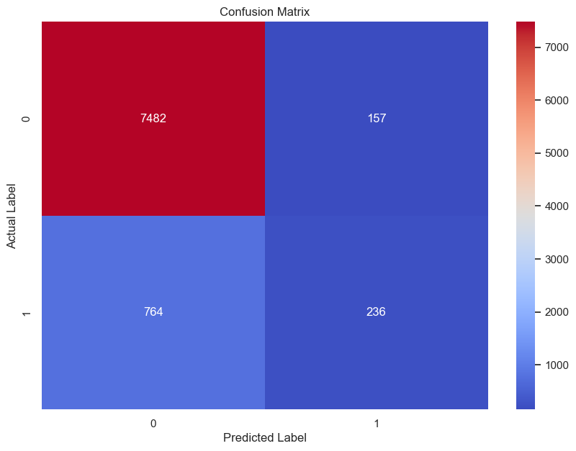
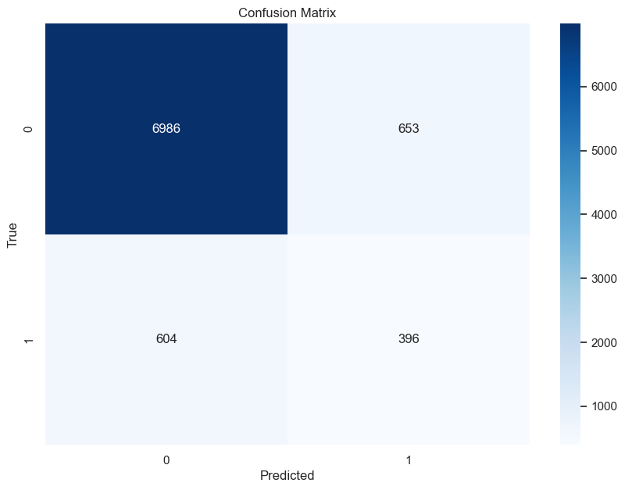
Logistic Regression
Support Vector Machine (SVM)
Decision Tree

Slide 12
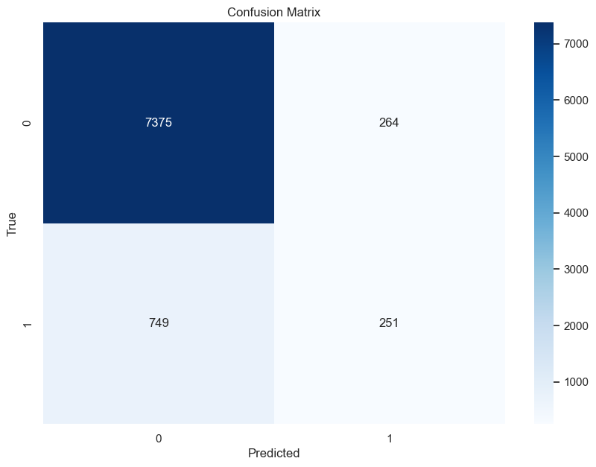
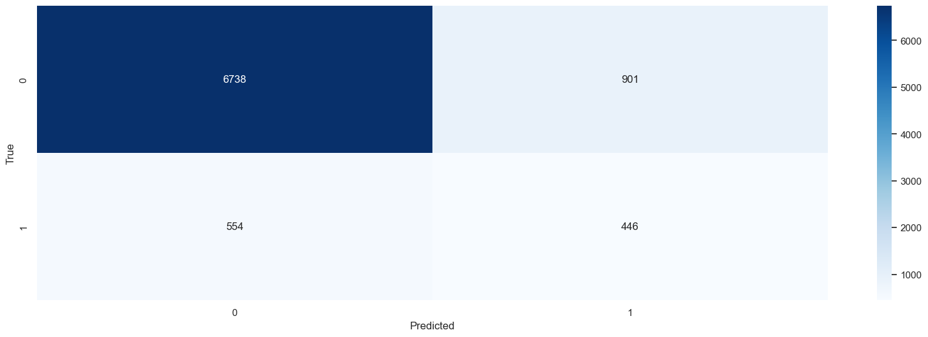
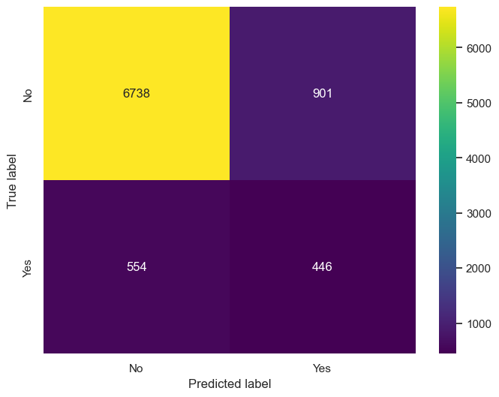
K-Nearest Neighbors
Naive Bayes
Random Forest

Slide 13
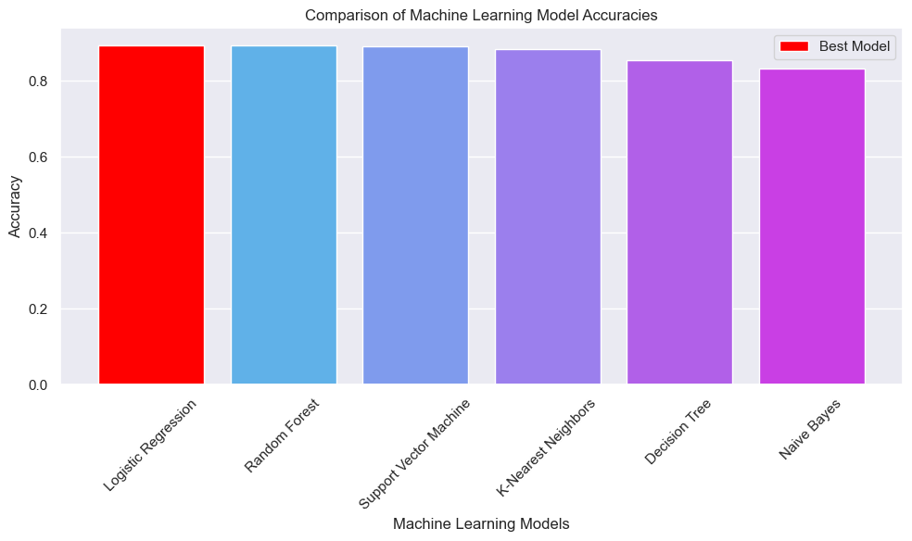

Slide 14
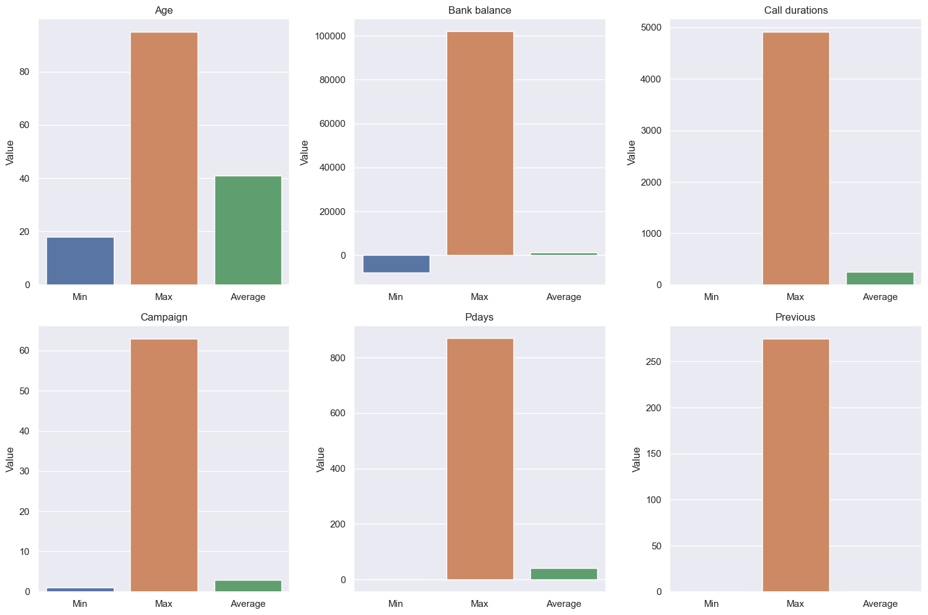
Fifth: Findings & Conclusion
So, How can the bank increase subscriptions ??

Slide 15
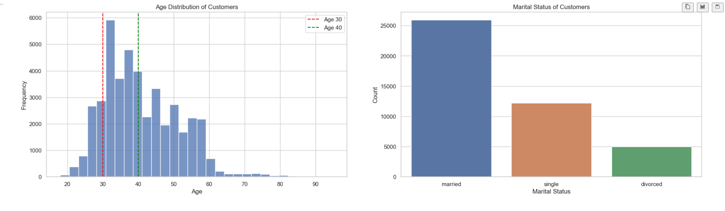

Slide 16
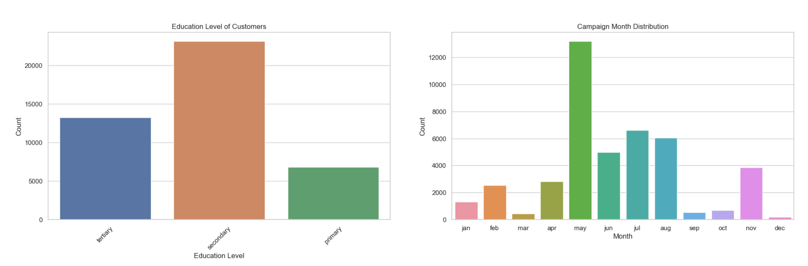

Slide 17
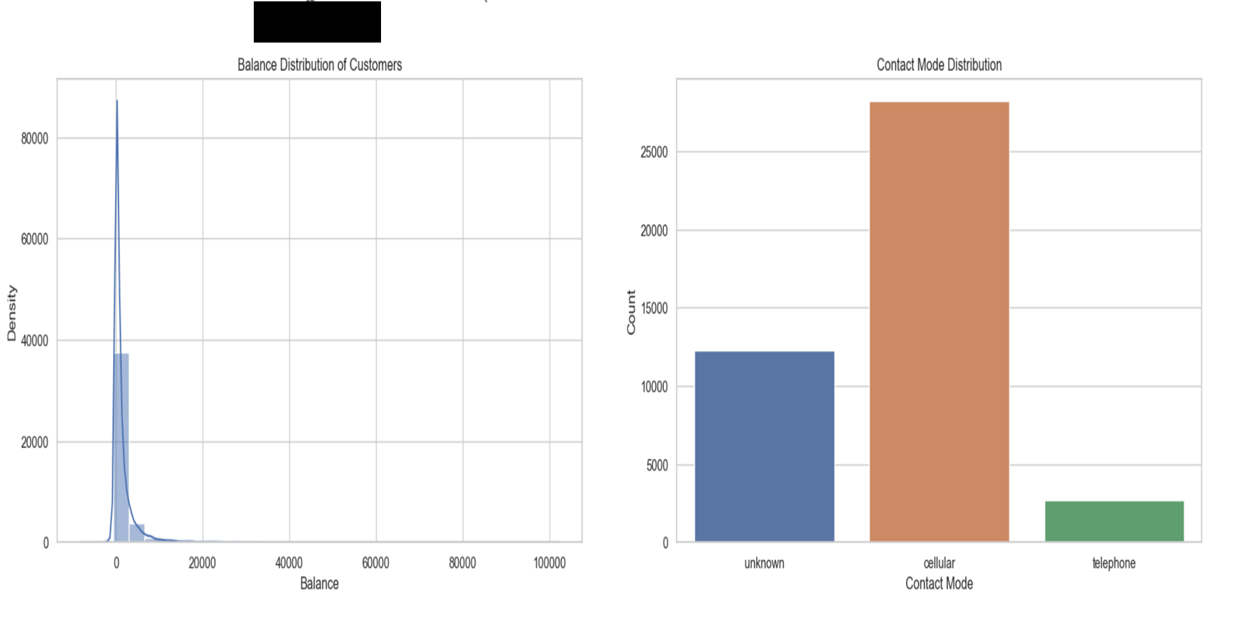

Slide 18
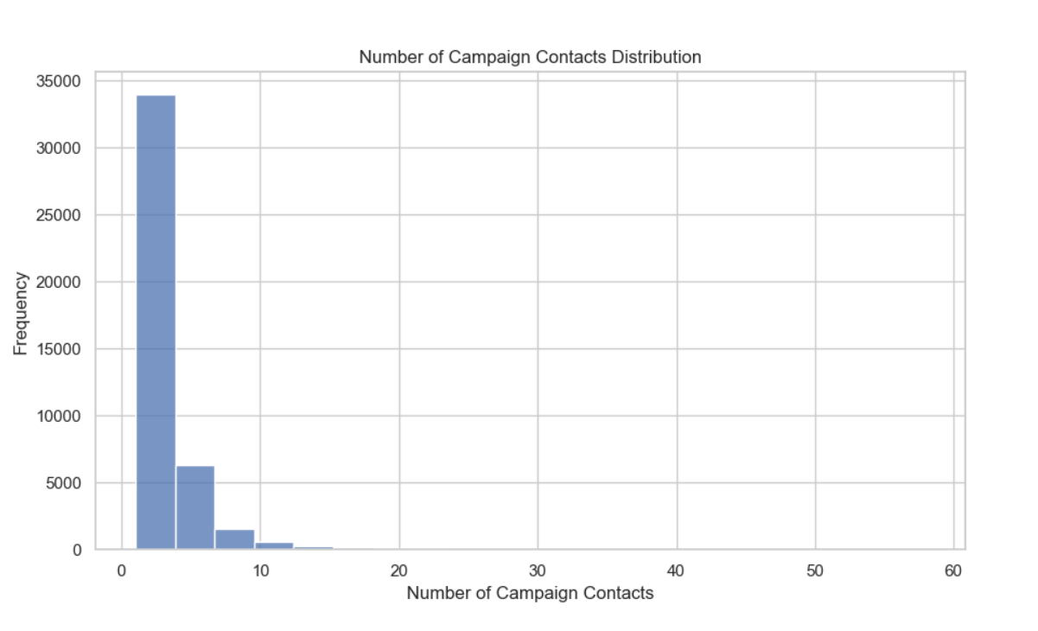

Slide 19
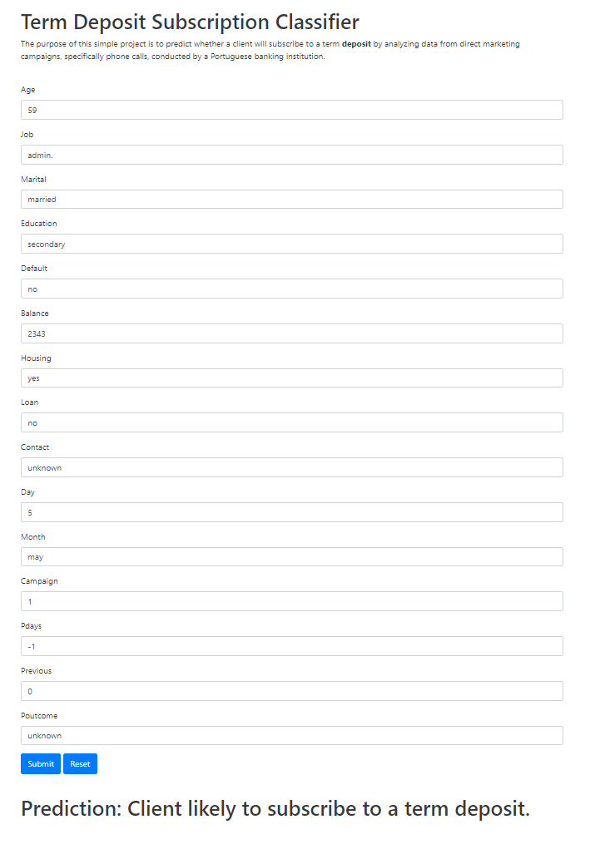
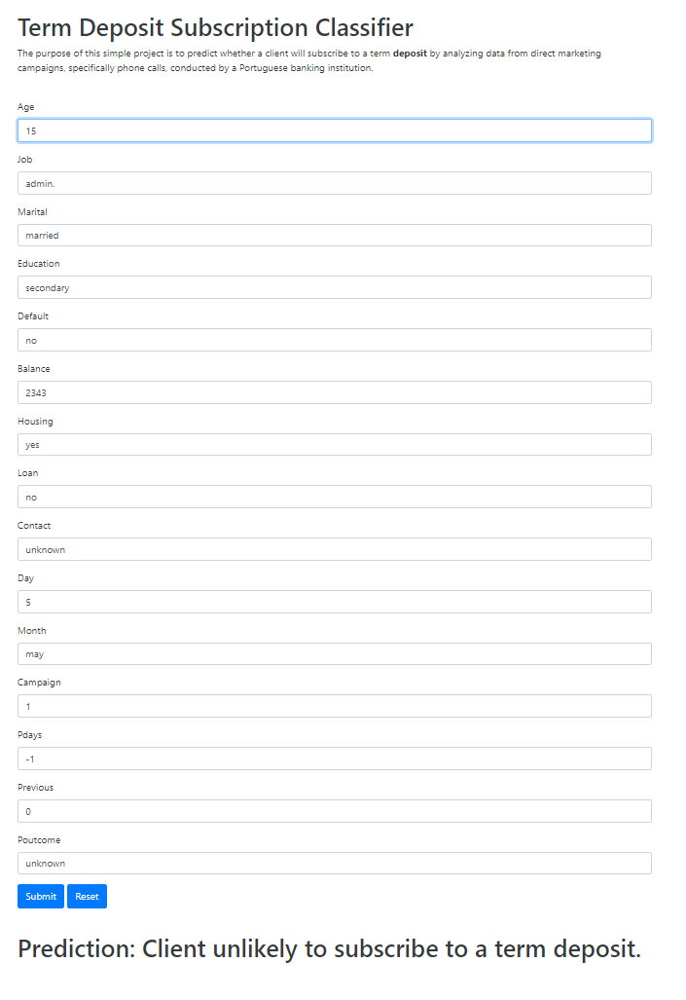
Sixth : Build flask frame

Slide 20
Thank you

